Slide 1
Picraft API
An alternate Minecraft API

Slide 2
Picraft
A Minecraft: Pi Edition API
For Python 2 & Python 3 (mcpi is Python 2 only)
Rewritten API with more “pythonic” style
Installation Instructions:
sudo apt-get update && sudo apt-get install python3-pip
sudo pip-3.2 install picraft

Slide 3
On Startup
Log in with usual credentials
Username: ‘pi’ Password: ‘raspberry’
The SD card has been newly imaged, so you may wish to do some setup steps (not necessary):
Type ‘sudo raspi-config’ and press enter
select ‘expand filesystem’, and confirm
enable boot to desktop (2nd option)
Select finish, and accept the restart
Type the command ‘startx’ and press Enter
Open IDLE 3 (The blue/yellow icon in quick launch bar)

Slide 4
Hello, World
With the new API

Slide 5
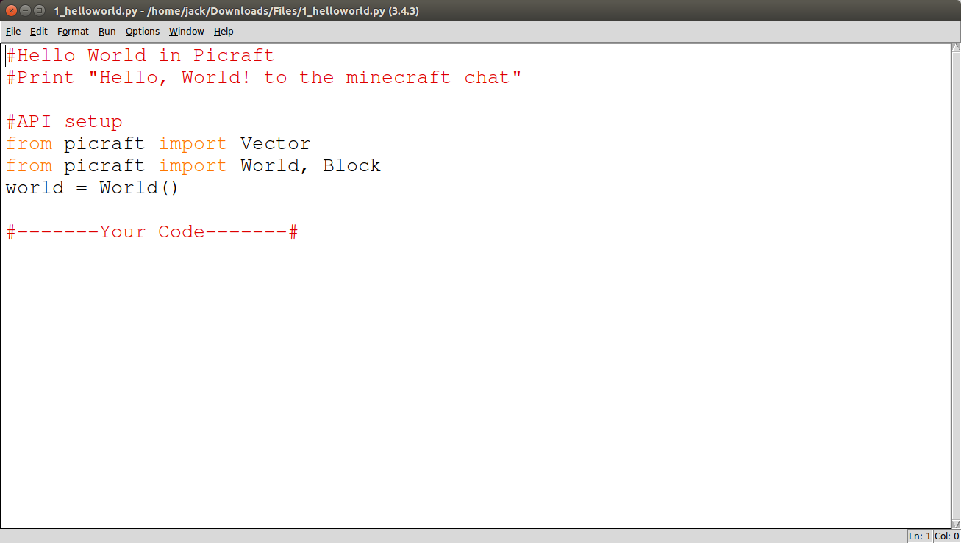
Hello, World
With the new API
Open 1_helloworld.py
File > Open
~/Minecraft-Scripts/Workshop-006/1_helloworld.py

Slide 6
Hello, World
With the new API
Add the following line:
world.say(“Hello, World!”)

Slide 7
Python Functions
Separating your code

Slide 8
Python Functions
Separating your code
Functions are a way of separating pieces of code
sometimes just to improve readability
usually because the code can be reused.
You’ve probably used functions written by other people, as part of libraries
function_name(parameter, parameter, ..)
e.g. print(“String parameter”)

Slide 9
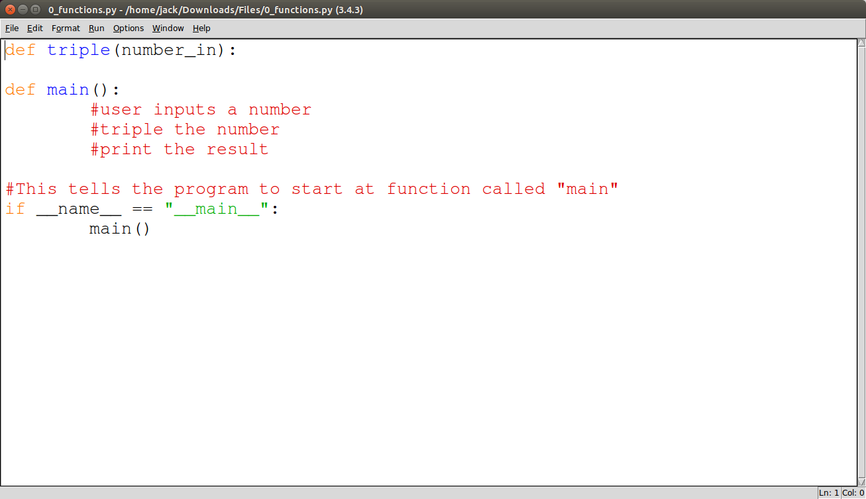
Python Functions
Separating your code
Open 0_functions.py
File > Open
~/Minecraft-Scripts/Workshop-006/0_functions.py

Slide 10
Python Functions
Separating your code
#user inputs a number
number = int(input("Enter a number:"))
#triple the number
number = triple(number)
#print the result
print(number)

Slide 11
Python Functions
Separating your code
number = triple(number) is setting number to a value.
We have to “return” a value from the function
tripled = number_in * 3
return tripled
or
return number_in*3

Slide 12
Picraft Basics
Change a block

Slide 13
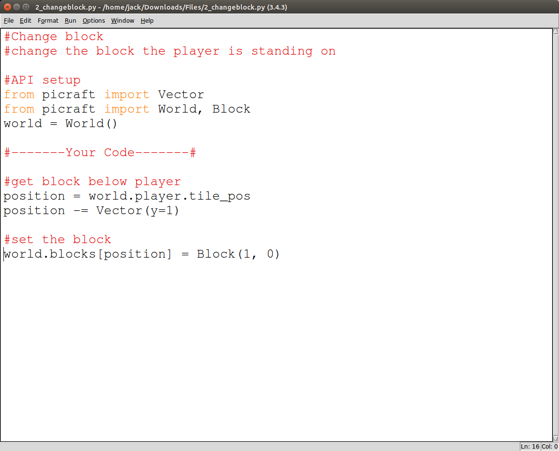
Picraft Basics
Change a block
Open 2_changeblock.py
File > Open
~/Minecraft-Scripts/Workshop-006/2_changeblock.py

Slide 14
Picraft Basics
Change a block
#get the player’s position
position = world.player.tile_pos
#move the position below the player's feet
position -= Vector(y=1)
#set the block
world.blocks[position] = Block(1, 0)

Slide 15
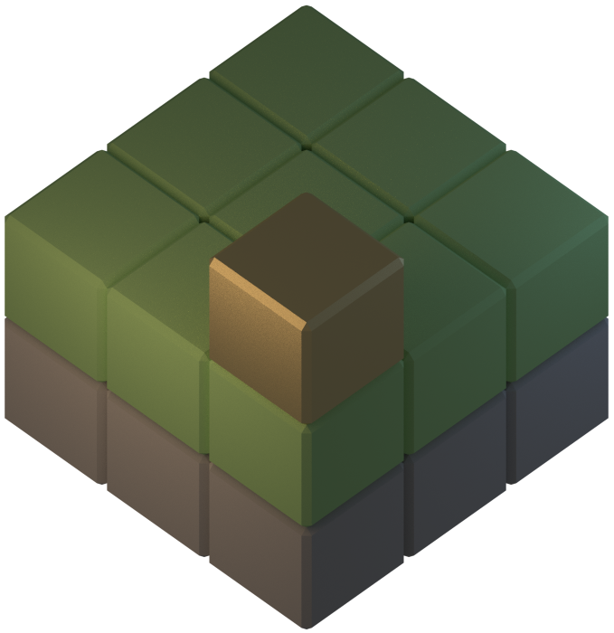
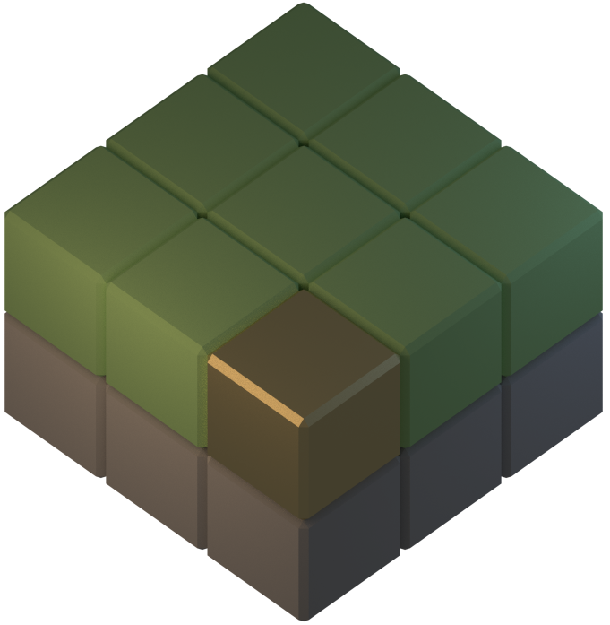
Picraft Basics
Change a block
position -= Vector(y=1)
(

Slide 16
The Sword of Exploding TNT
=O

Slide 17
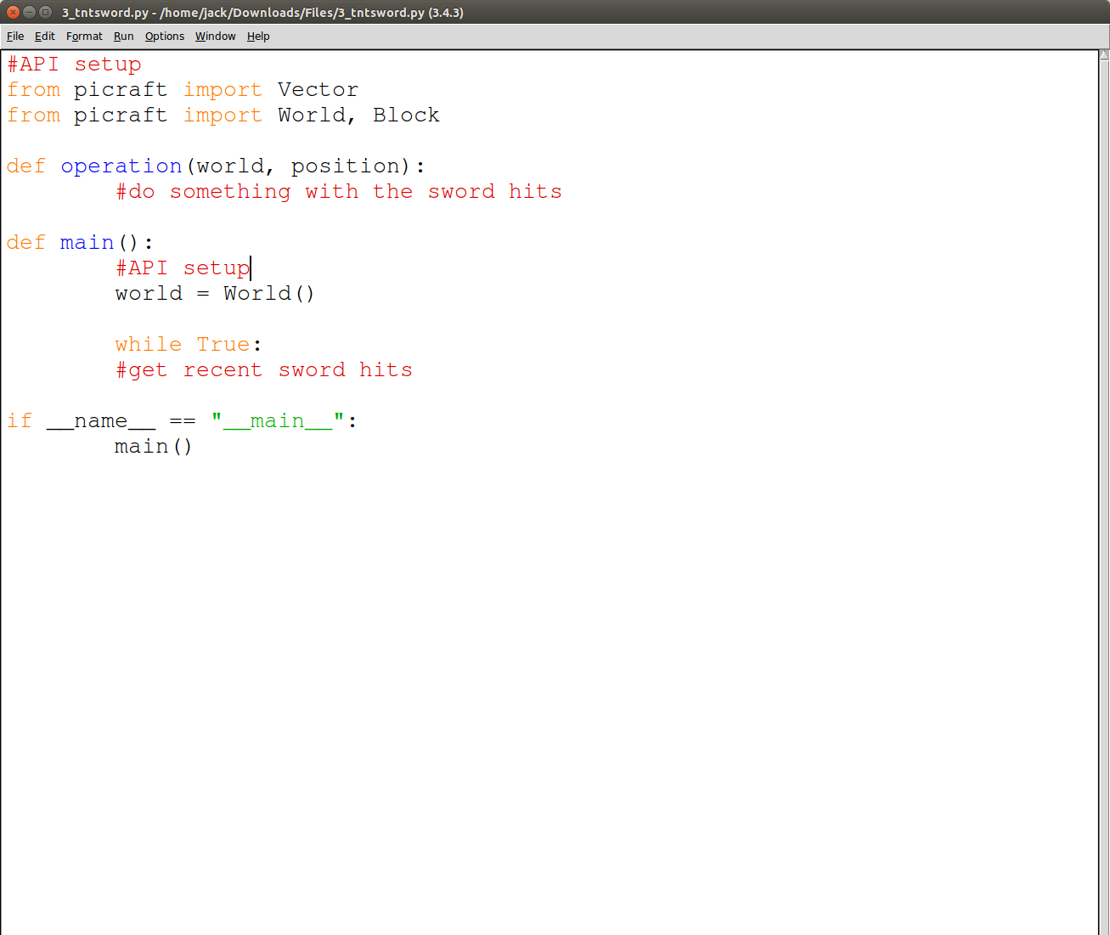
The Sword of Exploding TNT
=O
Open 3_tntsword.py
File > Open
~/Minecraft-Scripts/Workshop-006/3_tntsword.py

Slide 18
The Sword of Exploding TNT
=O
while True:
#get recent sword hits
hits = world.events.poll()
for hit in hits:
currenthit = hit.pos
operation(world, currenthit)

Slide 19
The Sword of Exploding TNT
=O
def operation(world, position):
for depth in range(0, 32):
world.blocks[position - Vector(y=depth)] = Block(46, 1)

Slide 20
Placeable Furniture
Slides incomplete

Slide 21
world.blocks[position] = Block(53, 0)

Slide 22
for hit in hits:
currenthit = hit.pos
#operation(world, currenthit)
world.say(hit.face)

Slide 23
def face_to_dataval(face):
if face == 'x-':
return 0
elif face == 'x+':
return 1
elif face == 'z-':
return 2
elif face == 'z+':
return 3
else:
print('Error: you hit the top face')
return -1

Slide 24
def operation(world, position, data):
#center block
world.blocks[position] = Block(53, data)
#left block
new_position = translate_left(position, data)
new_data = rotate_anticlockwise(data)
world.blocks[new_position] = Block(53, new_data)
#right block
new_position = translate_right(position, data
new_data = rotate_clockwise(data)
world.blocks[new_position] = Block(53, new_data)

Slide 25
def translate_left(position, data):
if data == 0:
return position - Vector(z=1)

